Slide 1
BAYESIAN LEARNING
Bayesian Classifiers
Bayesian reasoning provides a probabilistic approach to inference
Bayesian classifiers are statistical classifiers, and are based on Baye’s theorem
They can calculate the probability that a given sample belongs to a particular class

Slide 2
BAYESIAN LEARNING
Bayesian Classifiers
Bayesian learning algorithms are among the most practical approaches to certain types of learning problems.
There results are comparable to the performance of other classifiers, such as decision tree and neural networks in many cases

Slide 3
BAYESIAN LEARNING
Naïve (Simple) Bayesian Classification
Studies comparing classification algorithms have found that the simple Bayesian classifier is comparable in performance with decision tree and neural network classifiers
It works as follows:
1. Each data sample is represented by an n-dimensional feature vector, X = (x₁, x₂, …, x_{n}), depicting n measurements made on the sample from n attributes, respectively A₁, A₂, … A_{n}

Slide 4
BAYESIAN LEARNING
Naïve (Simple) Bayesian Classification
2. Suppose that there are m classes C₁, C₂, … C_{m}. Given an unknown data sample, X (i.e. having no class label), the classifier will predict that X belongs to the class having the highest posterior probability given X
Thus if P(C_{i}|X) > P(C_{j}|X) for 1 ≤ j ≤ m , j ≠ i
then X is assigned to C_{i}
This is called Bayes decision rule

Slide 5
BAYESIAN LEARNING
Naïve (Simple) Bayesian Classification
3. We have P(C_{i}|X) = P(X|C_{i}) P(C_{i}) / P(X)
As P(X) is constant for all classes, only P(X|C_{i}) P(C_{i}) needs to be calculated
The class prior probabilities may be estimated by
P(C_{i}) = s_{i} / s
where s_{i} is the number of training samples of class C_{i}
& s is the total number of training samples
If class prior probabilities are equal (or not known and thus assumed to be equal) then we need to calculate only P(X|C_{i})

Slide 6
BAYESIAN LEARNING
Naïve (Simple) Bayesian Classification
4. Given data sets with many attributes, it would be extremely computationally expensive to compute P(X|C_{i})
For example, assuming the attributes of colour and shape to be Boolean, we need to store 4 probabilities for the category apple P(¬red ∧ ¬round | apple)
P(¬red ∧ round | apple)
P(red ∧ ¬round | apple)
P(red ∧ round | apple)
If there are 6 attributes and they are Boolean, then we need to store 2⁶ probabilities

Slide 7
BAYESIAN LEARNING
Naïve (Simple) Bayesian Classification
Furthermore, the data may not be abundant and some of the probabilities may come out to be zero or close to zero.
In order to reduce computation, and also to avoid the effect of scarcity of data the naïve assumption of class conditional independence is made
This presumes that the values of the attributes are conditionally independent of one another, given the class label of the sample (we assume that there are no dependence relationships among the attributes)

Slide 8
BAYESIAN LEARNING
Naïve (Simple) Bayesian Classification
Thus we assume that P(X|C_{i}) = ∏^{n}_{k=1} P(x_{k}|C_{i})
Example
P(colour ∧ shape | apple) = P(colour | apple) P(shape | apple)
For 6 Boolean attributes, we would have only 12 probabilities to store instead of 2⁶ = 64
Similarly for 6, three valued attributes, we would have 18 probabilities to store instead of 3⁶

Slide 9
BAYESIAN LEARNING
The probabilities P(x₁|C_{i}), P(x₂|C_{i}), …, P(x_{n}|C_{i}) can be estimated from the training samples, where
For an attribute A_{k}, which can take on the values x_{1k}, x_{2k}, …
e.g. colour = red, green, …
P(x_{k}|C_{i}) = s_{ik}/s_{i}
where s_{ik} is the number of training samples of class C_{i} having the value x_{k} for A_{k}
and s_{i} is the number of training samples belonging to C_{i}
e.g. P(red|apple) = 7/10 if 7 out of 10 apples are red

Slide 10
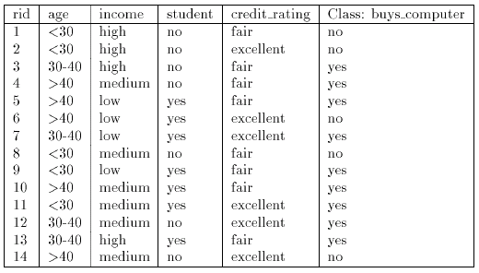
BAYESIAN LEARNING
Naïve (Simple) Bayesian Classification
Example:

Slide 11
BAYESIAN LEARNING
Naïve (Simple) Bayesian Classification
Example:
Let C₁ = class buy computer and C₂ = class not buy computer
The unknown sample:
X = {age < 30, income = medium, student = yes, credit-rating = fair}
The prior probability of each class can be computed as
P(buy computer = yes) = 9/14 = 0.643
P(buy_computer = no) = 5/14 = 0.357

Slide 12
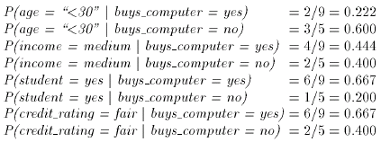
BAYESIAN LEARNING
Naïve (Simple) Bayesian Classification
Example:
To compute P(X|Ci) we compute the following conditional probabilities

Slide 13
BAYESIAN LEARNING
Naïve (Simple) Bayesian Classification
Example:
Using the above probabilities we obtain
And hence the naïve Bayesian classifier predicts that the student will buy computer, because

Slide 14
BAYESIAN LEARNING
Naïve (Simple) Bayesian Classification
An Example: Learning to classify text
  Instances (training samples) are text documents
  Classification labels can be: like-dislike, etc.
  The task is to learn from these training examples to predict the class of unseen documents
Design issue:
- How to represent a text document in terms of attribute values

Slide 15
BAYESIAN LEARNING
Naïve (Simple) Bayesian Classification
One approach:
- The attributes are the word positions
- Value of an attribute is the word found in that position
Note that the number of attributes may be different for each document
We calculate the prior probabilities of classes from the training samples
Also the probabilities of word in a position is calculated
e.g. P(“The” in first position | like document)

Slide 16
BAYESIAN LEARNING
Naïve (Simple) Bayesian Classification
Modification:
The presence or absence of a word irrespective of its position in the document
Note that the number of attributes can still be different for each document
The probabilities of words are
e.g. P(“The” | like document)

Slide 17
BAYESIAN LEARNING
Naïve (Simple) Bayesian Classification
Modification:
Do not use very frequently words nor rarely occurring words
  100 most frequent words were removed (these include words such as “the”, and “of”)
  Any word occurring fewer than 3 times was also removed

Slide 18
BAYESIAN LEARNING
Naïve (Simple) Bayesian Classification
Results
An algorithm based on the second approach was applied to the problem of classifying articles of news groups
  20 newsgroups were considered
  1,000 articles of each news group were collected (total 20,000 articles)
  The naïve Bayes algorithm was applied using 2/3rd of these articles as training samples
  Testing was done over the remaining 3rd

Slide 19
BAYESIAN LEARNING
Naïve (Simple) Bayesian Classification
Results
  Given 20 news groups, we would expect random guessing to achieve a classification accuracy of 5%
  The accuracy achieved by this program was 89%

Slide 20
Bayesian Belief Networks

Slide 21
BAYESIAN LEARNING
Bayesian Belief Networks
Since in real world dependencies can exist between variables, hence Bayesian belief networks are used to specify joint conditional probability distributions
They allow class conditional independencies to be defined between subset of variables
They provide a graphical model of causal relationships, on which learning can be performed
These networks are also called belief networks, Bayesian networks, and probabilistic networks

Slide 22
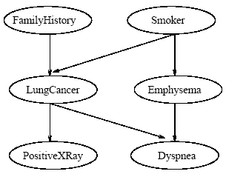
BAYESIAN LEARNING
Bayesian Belief Networks
A belief network is defined by two components
The first is a directed acyclic graph, where each node represents a random variable and each arc represents a probabilistic dependence

Slide 23
BAYESIAN LEARNING
Bayesian Belief Networks
If an arc is drawn from a node Y to a node Z, then Y is a parent of Z and Z is a descendent of Y
Each variable is conditionally independent of its non descendents in the graph, given its parents
The variables may be discrete
or continuous

Slide 24

BAYESIAN LEARNING
Bayesian Belief Networks
The second component of a belief network consists of a conditional probability table for each variable
For a variable Z, it specifies the conditional probability distribution P(Z|Parents(Z))
The conditional probability for each value of Z is listed for each possible combination of values of its parents

Slide 25

BAYESIAN LEARNING
Bayesian Belief Networks
The joint probability of any tuple (z₁, …, z_{n}) corresponding to the attributes Z₁, …, Z_{n} is computed by
Where the values P(z_{i}|Parents(Z_{i})) correspond to the entries in the CPT for z_{i}

Slide 26
BAYESIAN LEARNING
Bayesian Belief Networks
A node within the network can be selected as an output node representing a class label attribute
The structure of the network can be given by an expert

Slide 27
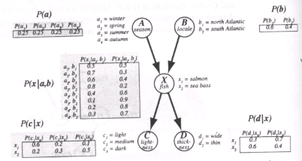
BAYESIAN LEARNING
Example: probability that a fish caught in summer, in the north Atlantic, is a sea bass, and is dark and thin:
P(a₃, b₁, x₂, c₃, d₂)
= P(a₃)P(b₁)P(x₂|a₃,b₁)P(c₃|x₂)P(d₂|x₂)
= 0.25 x 0.6 x0.4 x0.5 x0.4 = 0.012

Slide 28
BAYESIAN LEARNING
Learning Bayesian Belief Networks
The problem of learning a Bayes network is the problem of finding a network that best matches (according to some scoring metric) a training set of data
By finding a network we mean finding both the
- Structure of the net &
- the conditional probability tables (CPT) associated with each node)

Slide 29
BAYESIAN LEARNING
Learning Bayesian Belief Networks
Known Network Structure
If the structure of the network is known we only have to find the CPT
Often human experts can come up with the appropriate structure for a problem domain but not the CPT
If we have number of training samples, we can compute sample statistics for each node and its parents

Slide 30
BAYESIAN LEARNING
Learning Bayesian Belief Networks
Unknown Network Structure
If the network structure is not known, we must then attempt to find that structure, as well as its associated CPTs, that best fits the training data
In order to do so, we need
- a metric by which to store candidate networks
- a procedure for searching among possible structure

Slide 31
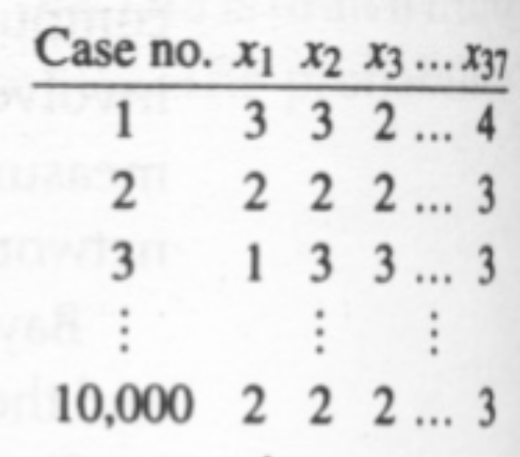

BAYESIAN LEARNING
Learning Bayesian Belief Networks

Slide 32

BAYESIAN LEARNING
Learning Bayesian Belief Networks

Slide 33
BAYESIAN LEARNING
Pros & Cons of Bayesian approach
It provides a more flexible approach to learning than algorithms that completely eliminate a hypothesis if it is found to be inconsistent with any single example. In Bayesian approach each observed training sample can gradually increase or decrease the estimated probability that a hypothesis is correct.
The probabilities used, can be incrementally updated if some new training samples arrive

Slide 34
BAYESIAN LEARNING
Pros & Cons of Bayesian approach
One practical difficulty in applying Bayesian methods is that they typically require initial knowledge of many probabilities
A second practical difficulty is the computational cost required to determine the Bayes optimal hypothesis in the general case (linear in the number of candidate hypotheses)

Slide 35
BAYESIAN LEARNING
Reference
Chapter 6 of T. Mitchell

